Slide 1
Marwan - What is Shapley Value and why do we need it?
Dominik - Mathematics behind Shapley Value
Sugarbayar - Example of applying Shapley values to the model
Bibliography
Explaining Shapley Values
Dominik Koterwa
Marwan Otrok
Sugarbayar Enkhbayar
Statistics and Exploratory Data Analysis, 2022
2022.11.29

Slide 2
Marwan - What is Shapley Value and why do we need it?
Dominik - Mathematics behind Shapley Value
Sugarbayar - Example of applying Shapley Values to the model
Bibliography
Shapley Values – a method from Cooperative Game Theory
Players
1
What is a fair distribution?
2
GAME
Payout
$$
3
4
Statistics and Exploratory Data Analysis, 2022
2/11

Slide 3
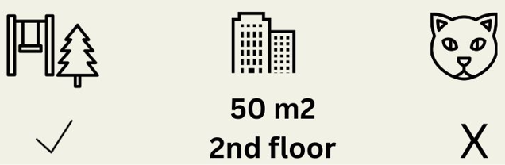
Marwan - What is Shapley Value and why do we need it?
Dominik - Mathematics behind Shapley Value
Sugarbayar - Example of applying Shapley Values to the model
Bibliography
Players? Game? Payout? What is the connection to machine learning predictions and interpretability?
Scenario:
$300,000
PREDICTION TASK
FEATURES
ACTUAL PREDICTION
Statistics and Exploratory Data Analysis, 2022
3/11

Slide 4
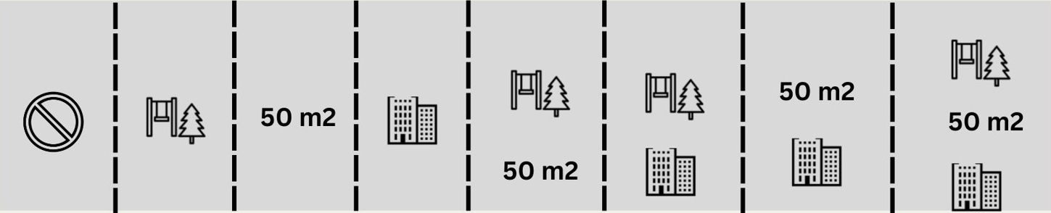
Marwan - What is Shapley Value and why do we need it?
Dominik - Mathematics behind Shapley Value
Sugarbayar - Example of applying Shapley Values to the model
Bibliography
How do we calculate the Shapley value for the one feature?
The Shapley value is the average marginal contribution of a feature value across all possible coalitions.
All 8 combinations needed for computing the exact Shapley Value of the feature value
Statistics and Exploratory Data Analysis, 2022
4/11

Slide 5
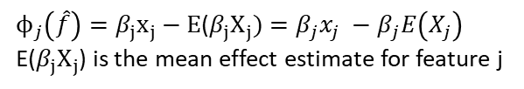

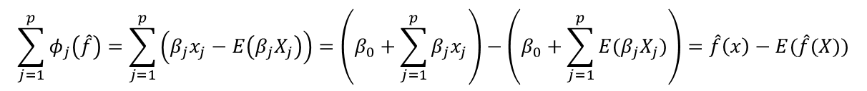
Marwan - What is Shapley Value and why do we need it?
Dominik - Mathematics behind Shapley Value
Sugarbayar - Example of applying Shapley Values to the model
Bibliography
$$\hat{f}\left(x\right)=β_{0}+β_{1}x_{1}+ …+β_{p}x_{p}$$
This is a linear model prediction
$ϕ_{j}\left(\hat{f}\right)=β_{j}x_{j}−E$($β_{j}X_{j})=β_{j}x_{j} −β_{j}E\left(X_{j}\right)$
E($β_{j}X_{j}$) is the mean effect estimate for feature j
Contribution of the j-th feature on the prediction
$$\sum_{j=1}^{p}{φ_{j}\left(\hat{f}\right)=\sum_{j=1}^{p}{\left(β_{j}x_{j}−E\left(β_{j}X_{j}\right)\right)=\left(β_{0}+\sum_{j=1}^{p}{β_{j}x_{j}}\right)−\left(β_{0}+\sum_{j=1}^{p}{E(β_{j}X_{j})}\right)}=\hat{f}\left(x\right)−E(\hat{f}(X))}$$
Sum of the contributions of features
But can we calculate it for a Black Box model?
Statistics and Exploratory Data Analysis, 2022
5/11

Slide 6
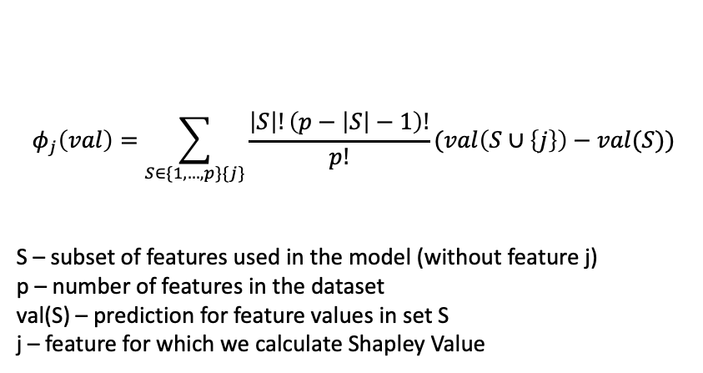
Marwan - What is Shapley Value and why do we need it?
Dominik - Mathematics behind Shapley Value
Sugarbayar - Example of applying Shapley Values to the model
Bibliography
Yes, we can!
$$φ_{j}\left(val\right)=\sum_{S∈\{1,…,p\}\{j\}}{\frac{\left|S\right|!\left(p−\left|S\right|−1\right)!}{p!}}(val\left(S∪\left\{j\right\}\right)−val(S))$$
S – subset of features used in the model (without feature j)
p – number of features in the dataset
val(S) – prediction for feature values in set S
j – feature for which we calculate Shapley Value
Statistics and Exploratory Data Analysis, 2022
6/11

Slide 7
Marwan - What is Shapley Value and why do we need it?
Dominik - Mathematics behind Shapley Value
Sugarbayar - Example of applying Shapley Values to the model
Bibliography
150$
No ad
The difference in revenues between using three ads and using no ad is:
150$ - 450$ = 300$
200$
300$
350$
Google ad
Social media
Email marketing
320$
350$
400$
Google ad
Google ad
Social media
Google ad
Social media
Email marketing
Social media
Email marketing
Email marketing
?
?
?
450$
450$
Google ad
150$
Google ad
No ad
300$
Social media
Social media
Email marketing
Email marketing
Statistics and Exploratory Data Analysis, 2022
7/11

Slide 8
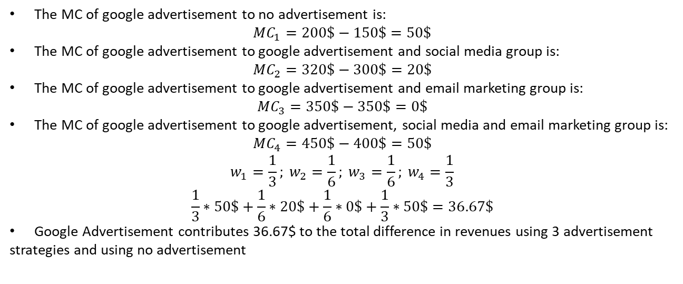

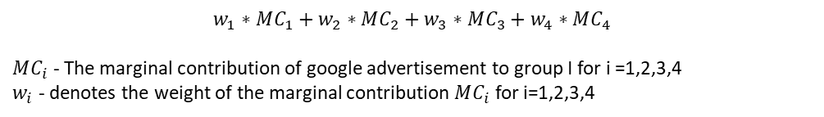



Marwan - What is Shapley Value and why do we need it?
Dominik - Mathematics behind Shapley Value
Sugarbayar - Example of applying Shapley Values to the model
Bibliography
150$
No ad
Let’s find marginal contribution of Google advertisement:
$$MC_{1}$$
$$w_{1}∗MC_{1}+w_{2}∗MC_{2}+w_{3}∗MC_{3}+w_{4}∗MC_{4}$$
$MC_{i}$ - The marginal contribution of google advertisement to group I for i =1,2,3,4
$w_{i}$ - denotes the weight of the marginal contribution $MC_{i}$ for i=1,2,3,4
200$
300$
350$
Google ad
Social media
Email marketing
The MC of google advertisement to no advertisement is:
$$MC_{1}=200\$−150\$=50\$$$
The MC of google advertisement to google advertisement and social media group is:
$$MC_{2}=320\$−300\$=20\$$$
The MC of google advertisement to google advertisement and email marketing group is:
$$MC_{3}=350\$−350\$=0\$$$
The MC of google advertisement to google advertisement, social media and email marketing group is:
$$MC_{4}=450\$−400\$=50\$$$
$$w_{1}=\frac{1}{3}; w_{2}=\frac{1}{6}; w_{3}=\frac{1}{6}; w_{4}=\frac{1}{3}$$
$$\frac{1}{3}∗50\$+\frac{1}{6}∗20\$+\frac{1}{6}∗0\$+\frac{1}{3}∗50\$=36.67\$$$
Google Advertisement contributes 36.67$ to the total difference in revenues using 3 advertisement
strategies and using no advertisement
$$MC_{2}$$
$$MC_{3}$$
400$
320$
350$
Google ad
Google ad
Social media
Social media
Email marketing
Email marketing
$$MC_{4}$$
450$
Google ad
Social media
Email marketing
Statistics and Exploratory Data Analysis, 2022
8/11

Slide 9
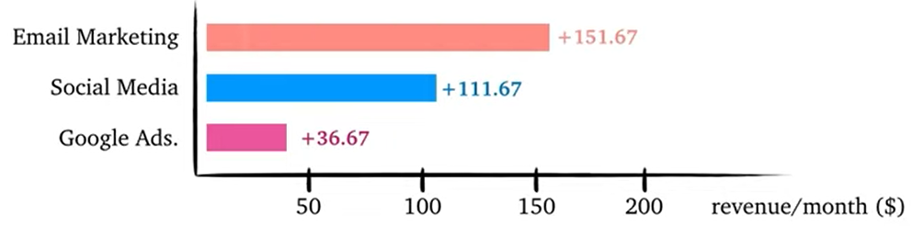
Marwan - What is Shapley Value and why do we need it?
Dominik - Mathematics behind Shapley Value
Sugarbayar - Example of applying Shapley Values to the model
Bibliography
Google ad
Social media
Email marketing
Email marketing has the largest positive contributions
Google Ads has the smallest positive contributions
151.67$
36.67$
111.67$
450$
150$
Google ad
No ad
300$
Social media
Email marketing
Statistics and Exploratory Data Analysis, 2022
9/11

Slide 10
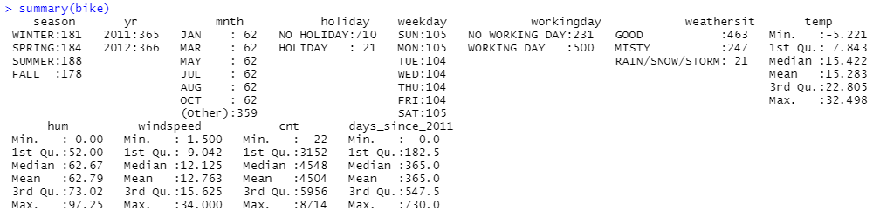
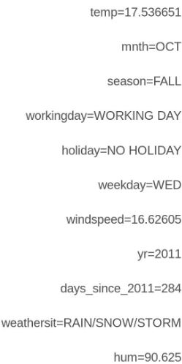
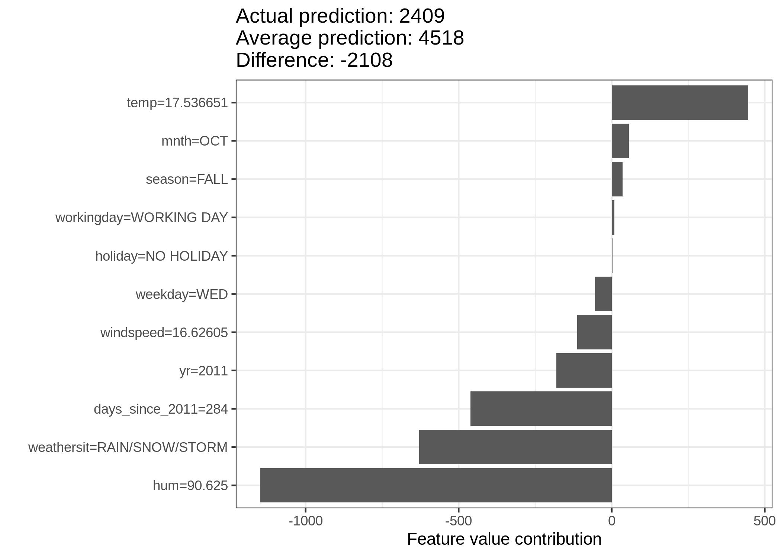
Marwan - What is Shapley Value and why do we need it?
Dominik - Mathematics behind Shapley Value
Sugarbayar - Example of applying Shapley Values to the model
Bibliography
This dataset contains daily counts of rented bicycles from the bicycle rental company Capital-Bikeshare in Washington D.C.,
along with weather and seasonal information.
The difference between prediction for analyzed observation and average prediction is -2108
The weather and humidity had the largest negative contributions. The temperature on this day has a positive contribution.
Data
X Variables
(Particular day)
Shapley values for day 285
Model
Random Forest
Statistics and Exploratory Data Analysis, 2022
10/11

Slide 11
Marwan - What is Shapley Value and why do we need it?
Dominik - Mathematics behind Shapley Value
Sugarbayar - Example of applying Shapley Values to the model
Bibliography
Molnar, C. (2019). Shapley Values. In C. Molnar, Interpretable Machine Learning (p. 177). Leanpub.
Tran, K. (2021, 9 24). SHAP: Explain Any Machine Learning Model in Python. Retrieved from towardsdatascience: https://towardsdatascience.com/shap-explain-any-machine-learning-model-in-python
Statistics and Exploratory Data Analysis, 2022
11/11

